Slide 1
Driven magnetohydrodynamic waves and shocks in Dusty Interstellar Plasma
Max P. Katz, Wayne G. Roberge, & Glenn E. Ciolek
Rensselaer Polytechnic Institute
Department of Physics, Applied Physics and Astronomy

Slide 2
Outline
Background and motivation
Wave physics in dust clouds
Example calculation: colliding clouds
Summary of results and future work

Slide 3
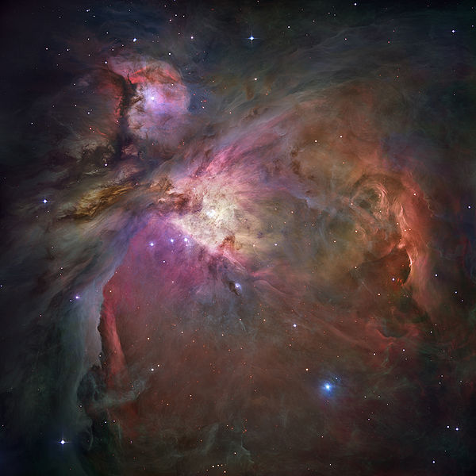
Molecular Clouds in the ISM
Large systems of gas dense enough to form molecules (typically H₂, also CO and others)
Star formation is generally
accepted to occur in these
dense regions
Dust grains (of a wide
range of sizes) form in
these cold environments
Orion Nebula, photo taken by HST

Slide 4
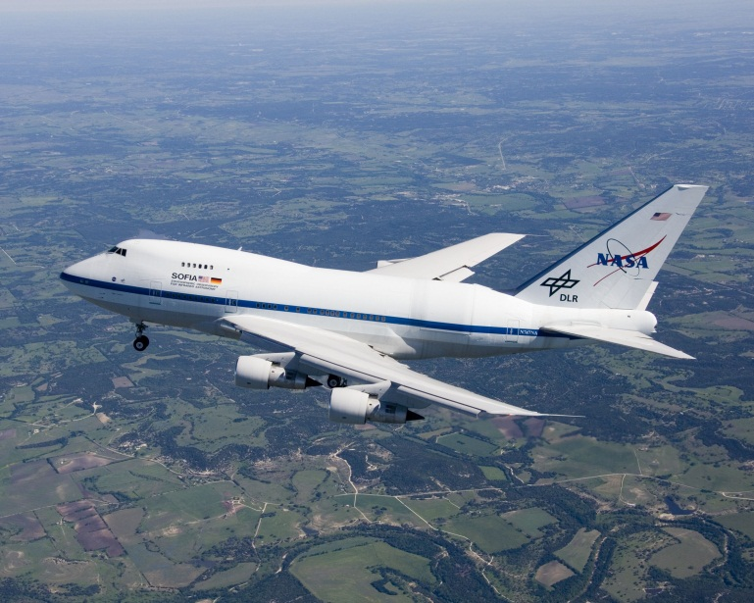
Dust in Molecular Cores
Molecular cores are the densest and most isolated parts of the cloud
Ices (including water) often deposit onto grains
If the grains are heated up, the ices can sublime off the grains; we can see this in the infrared
Observatories such as SOFIA
can then detect those
emission lines when they
look at clouds

Slide 5
How are Dust Grains Heated?
We study shocks within these clouds
Proto-stars often form polar outflows
(“jets”) of matter which slam into the
surrounding ISM, resulting in a
sudden compression and heating
HH47, photo taken by HST

Slide 6
MHD in the ISM
Clouds are often weakly ionized (rate is on the order of 1 in 10⁷ particles)
Internal magnetic fields generated are typically tens of µG (1 G ↔ 10⁻⁴ T)
Ions and free electrons exist, but there are also charged dust grains
In MHD (magnetohydrodynamics) we study the nature of how electromagnetic fields affect fluid dynamics, and vice versa

Slide 7
Motivation
Previous calculations have often ignored the effects of charged dust grains, and are therefore fairly non-realistic
We want to simulate these dusty systems to determine whether the presence of charged grains in plasmas affect the dynamics
This will guide future, more detailed calculations (i.e. full non-linear calculations)

Slide 8
Modeling the System
Interstellar clouds can be described as a multi-fluid system
We consider separate, interacting fluids:
Positively charged ions
Electrons
Grains (charge –e, radius a_{g})
These fluids are not very dense, and so we consider only EM interactions between them
They interact with the (much more common) neutral particles via drag forces

Slide 9
Classification of Systems
We consider two choices of the grain radius:
a_{g} = 50· 10⁻⁶ cm (Large Grain, or LG)
a_{g} = 5· 10⁻⁶ cm (Small Grain, or SG)
Observations indicate that dust grains generally comprise 1% of the total mass of the interstellar cloud
We take this ratio to be fixed, so the small grains are more abundant than the large grains

Slide 10
Modeling the System
We solve Maxwell’s equations, and the equation of conservation of momentum for each fluid:
$\frac{∂}{∂t}\vec{B}=−c∇×\vec{E }$
$∇×\vec{B}=\frac{4π}{c}\vec{J }$
$ρ_{f}\frac{∂}{∂t}\left(\vec{v_{f}}\right)+ρ_{f}\vec{v_{f}}∙∇\left(\vec{v_{f}}\right)= q_{f}n_{f}\left(\vec{E}+ \vec{\frac{v_{f}}{c}} × \vec{B}\right)+\frac{ρ_{f}}{τ_{fn}}\left(\vec{v_{n}} − \vec{v_{f}}\right)$

Slide 11
Modeling the System
We choose a Cartesian geometry and allow the magnetic field to be in the z-direction; we also eliminate the electric field from the equations
We consider motion of fluids in the x- and y-directions; motion in the z-direction is uncoupled

Slide 12
Solving the Equations
We linearize our equations, turn them into a dimensionless form, and take their Fourier transforms to get a system of five coupled ODEs
Characteristic parameters
$v_{0}=v_{iA}=912$ km/s
$τ_{0}= τ_{in}=0.013 yr$
$L_{0}=v_{iA}τ_{in}=3.6×{10}^{13}cm=2.4$ AU

Slide 13
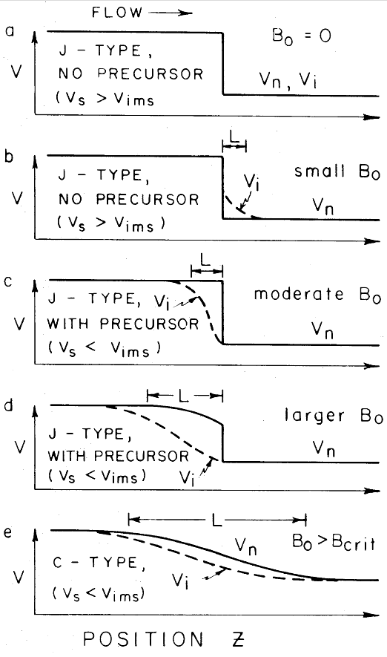
The Colliding Cloud Model
We model the jet colliding with the cloud as two identical clouds slamming into each other, resulting in a shock wave
Depending on the signal speeds involved, a magnetic precursor can form, which affects the charged fluid ahead of the shock front
Draine, 1980
Fig. 1

Slide 14
The Colliding Cloud Model
We assume that they approach each other at a relative velocity v = 20 km/s
Background magnetic field: B₀ = 50 μG
We look for linear perturbations to our initial state
Solved over several “decades,” with different scales for length and time

Slide 17
Summary of Results and Future Work
The signal speed is significantly decreased when a single species of dust grains is taken into account
This will affect predictions for what types of water emission lines and other interesting signatures SOFIA should look for
We are still in the process of collecting data for the current simulation
We can easily modify the code to simulate multiple species of grains with different radii

